Slide 1
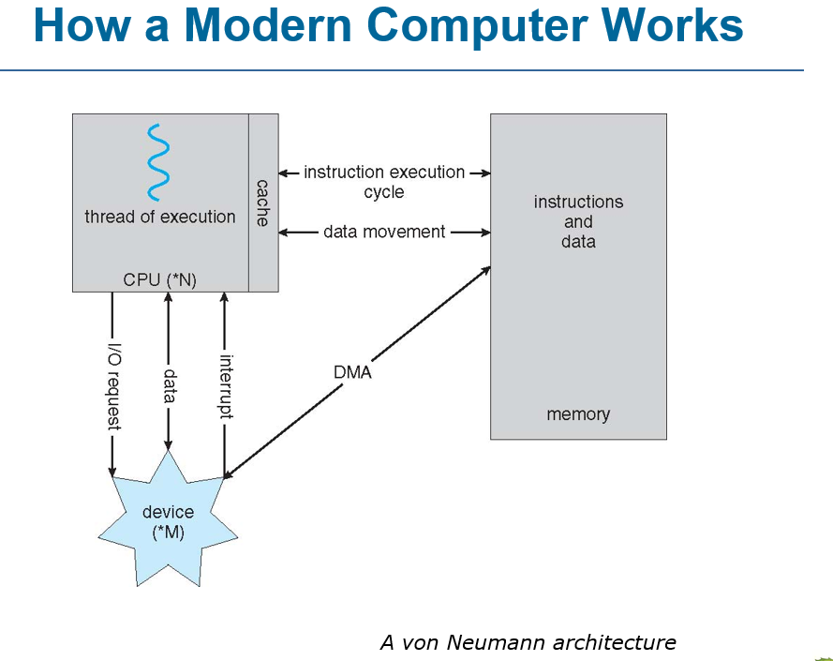
Notes:
VON NEUMANN ARCHITECTURE

Slide 2
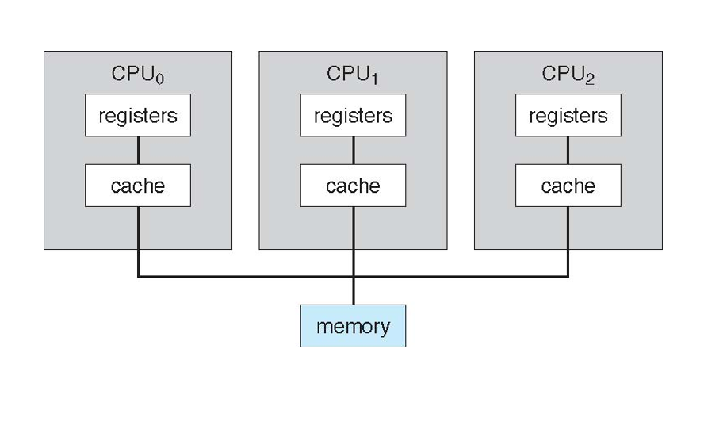
Notes:
SYMMETRIC MULTIPROCESSING ARCHITECTURE

Slide 3
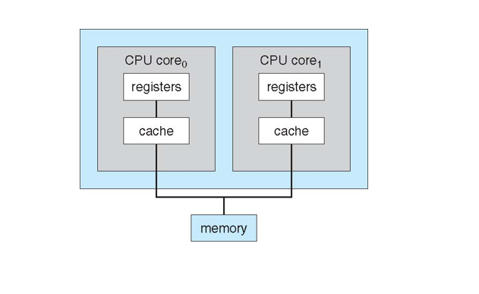
Notes:
DUAL CORE DESIGN

Slide 4
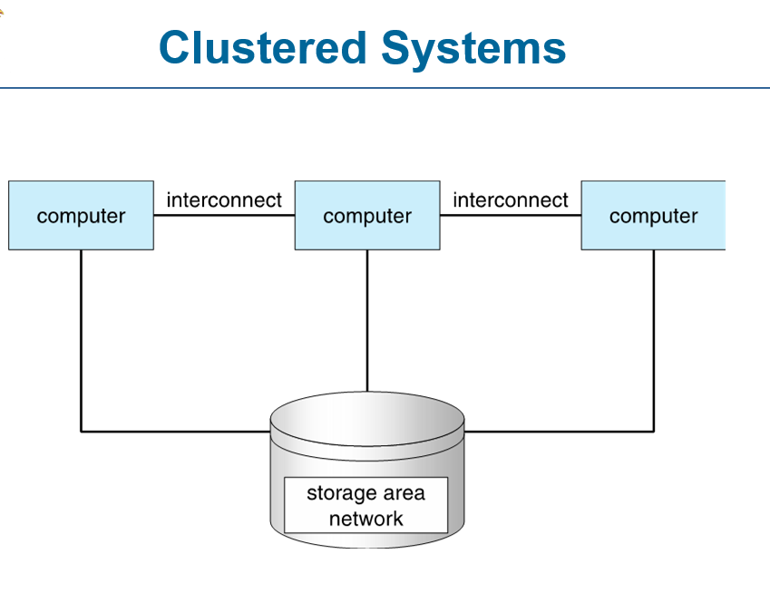

Slide 5
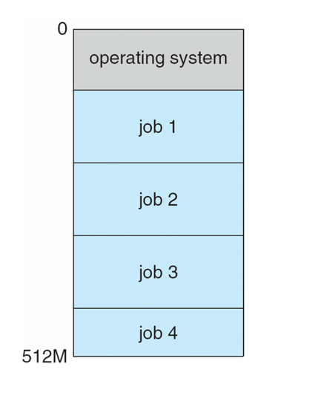
Memory Layout for Multiprogrammed System

Slide 6
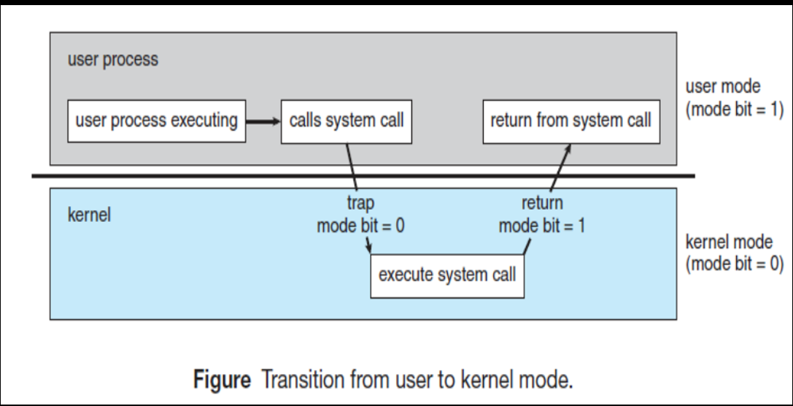
Dual mode operation

Slide 7
STORAGE MANAGEMENT
file system management
Mass storage management
Caching
I/O systems

Slide 8
File system management
Creating and deleting files
Creating and deleting directories to organize files
Supporting primitives for manipulating files and directories
Mapping files onto secondary storage
Backing up files on stable storage media

Slide 9
Mass storage management
Free space management
Storage allocation
Disk scheduling

Slide 10
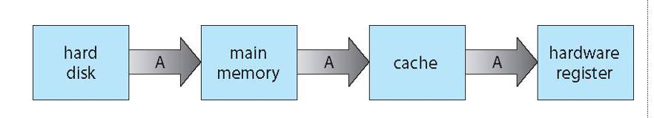
Caching
MIGRATION OF INTEGER A FROM DISK TO REGISTER

Slide 11
I/O systems
I/O subsystem: is a part of operating system that manages
communication between the CPU and I/O devices.
A memory management component that includes buffering, caching, and spooling
A general device interface
Drivers for specific hardware devices

Slide 12
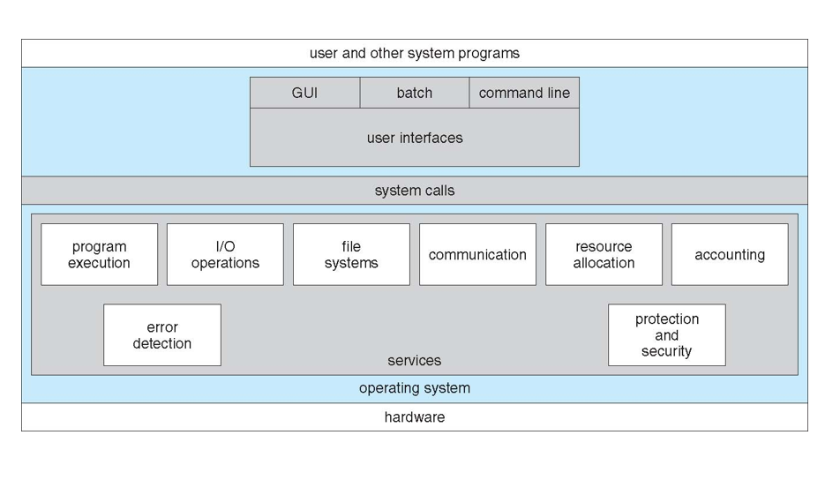
OPERATING SYSTEM SERVICES

Slide 13
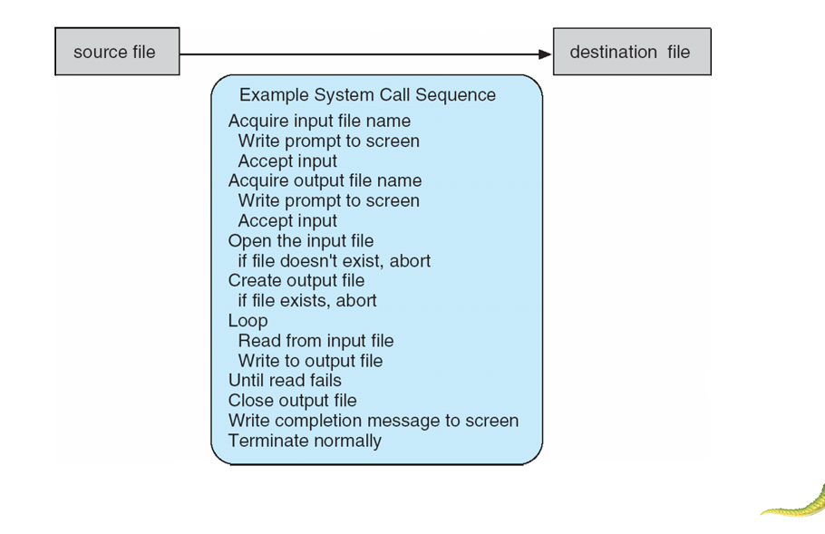

Slide 14
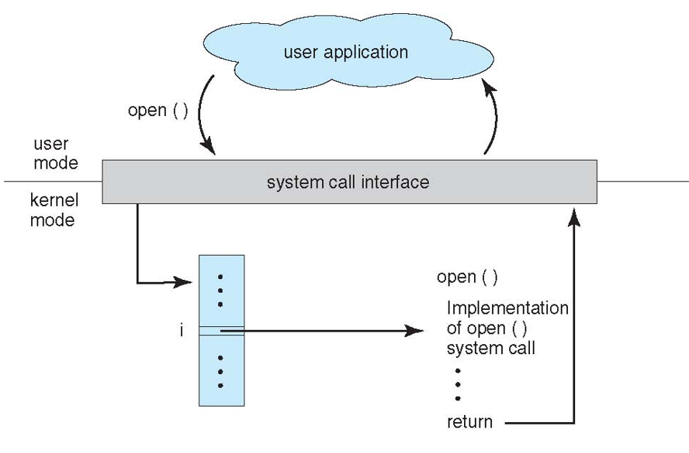
The handling of user application invoking open() system call

Slide 15
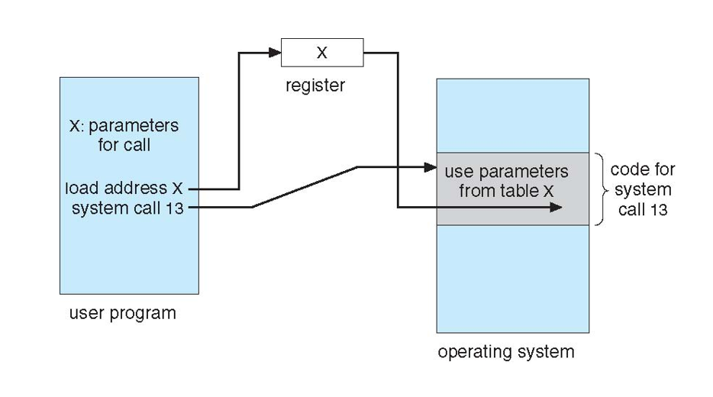
Passing of parameters as a table

Slide 16
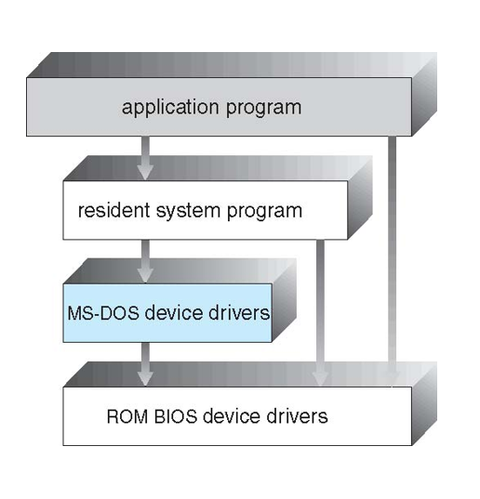
SIMPLE STRUCTURE

Slide 17
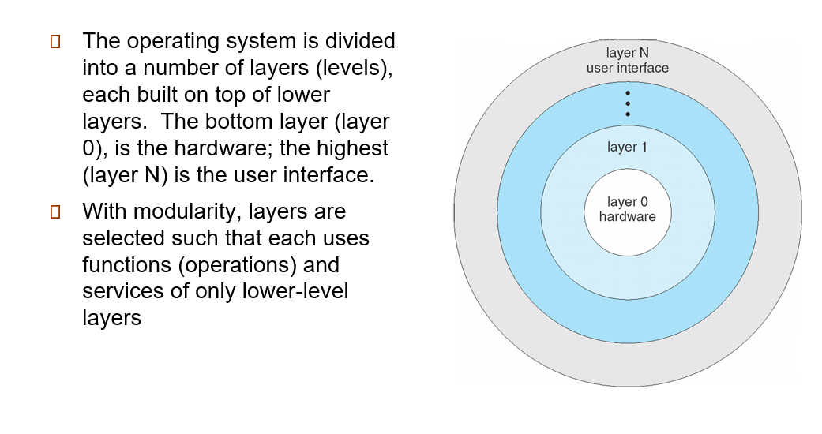

Slide 18
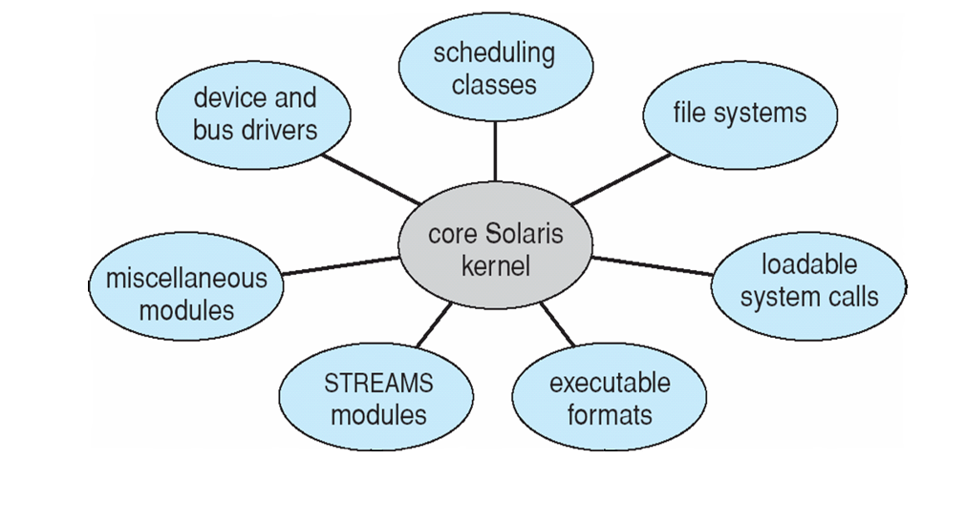
MODULES
Solaris Loadable Modules

Slide 19
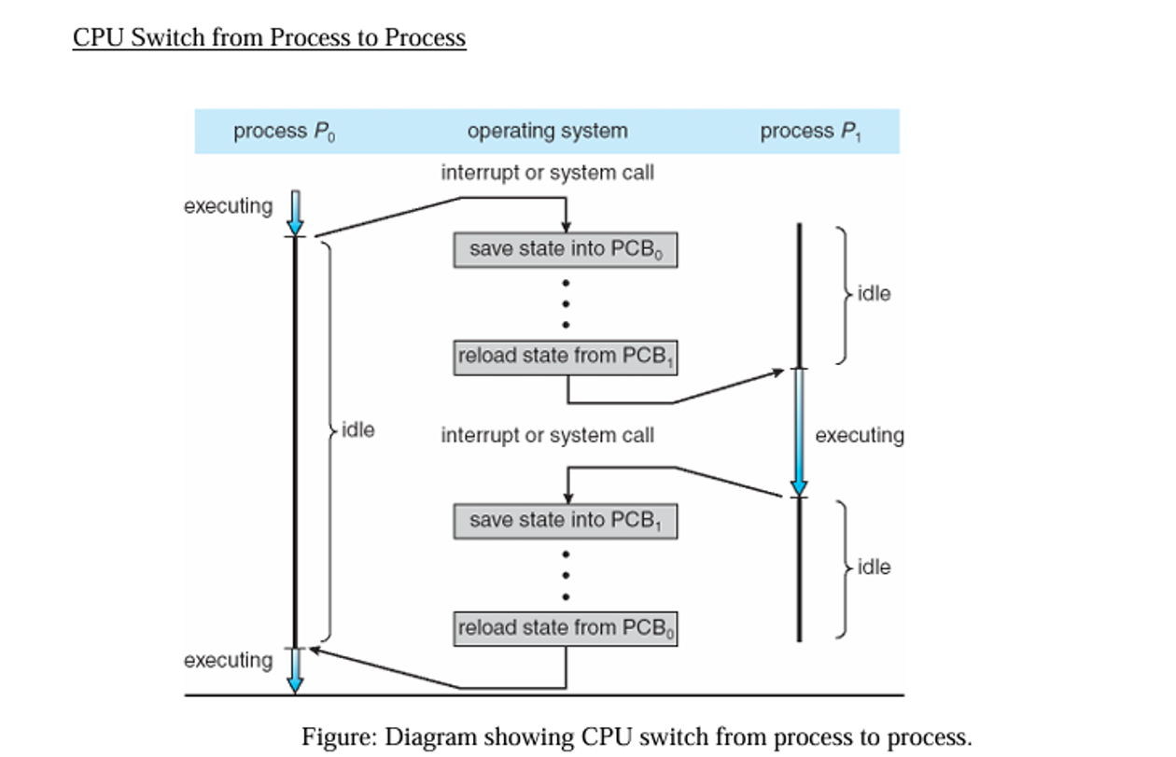

Slide 20
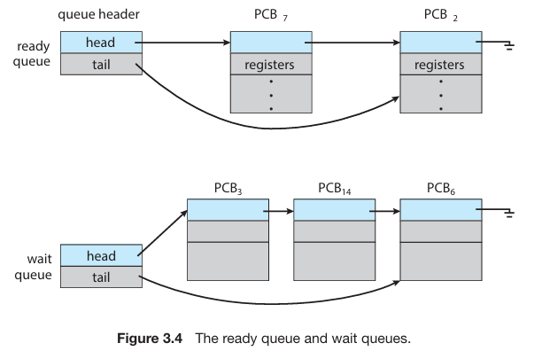
Scheduling queues

Slide 21
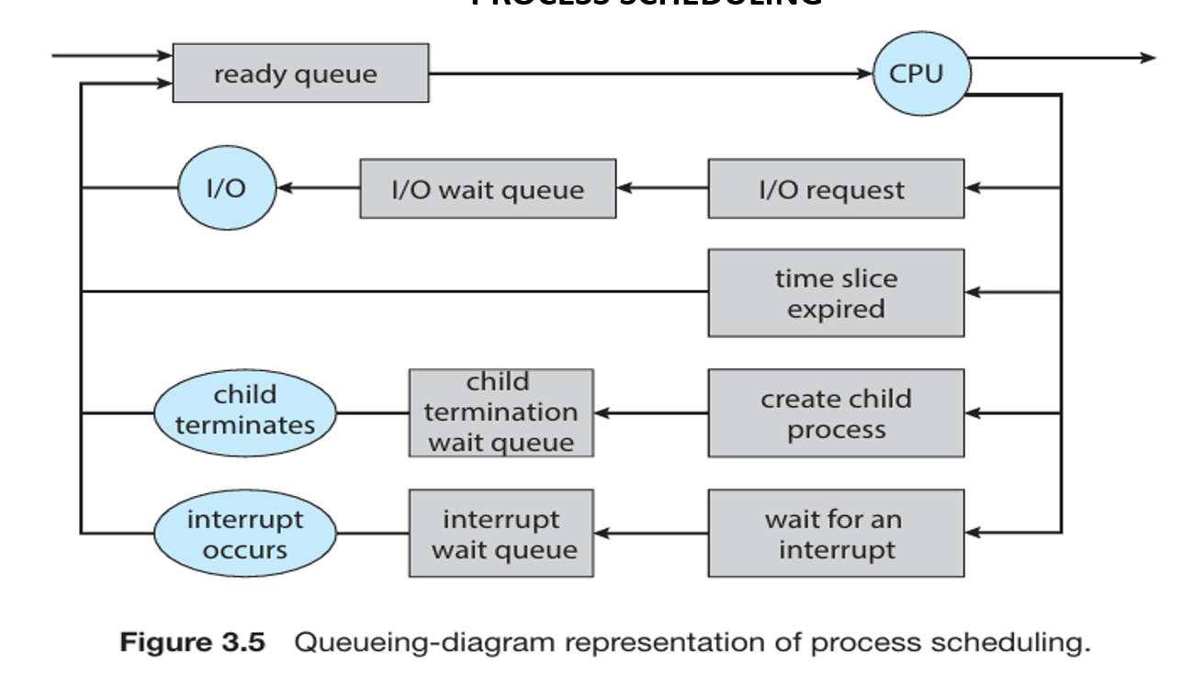

Slide 22
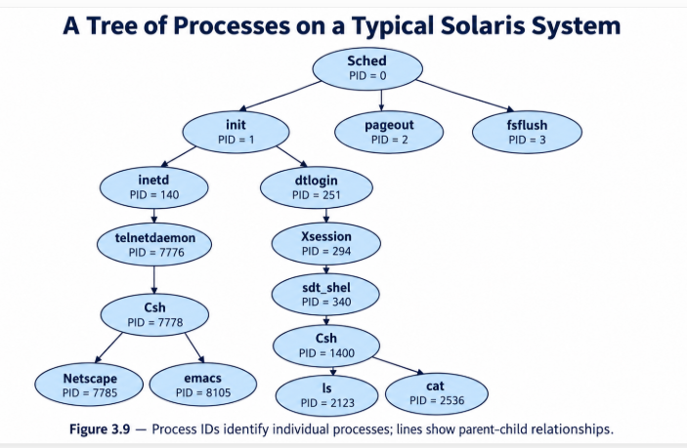

Slide 23
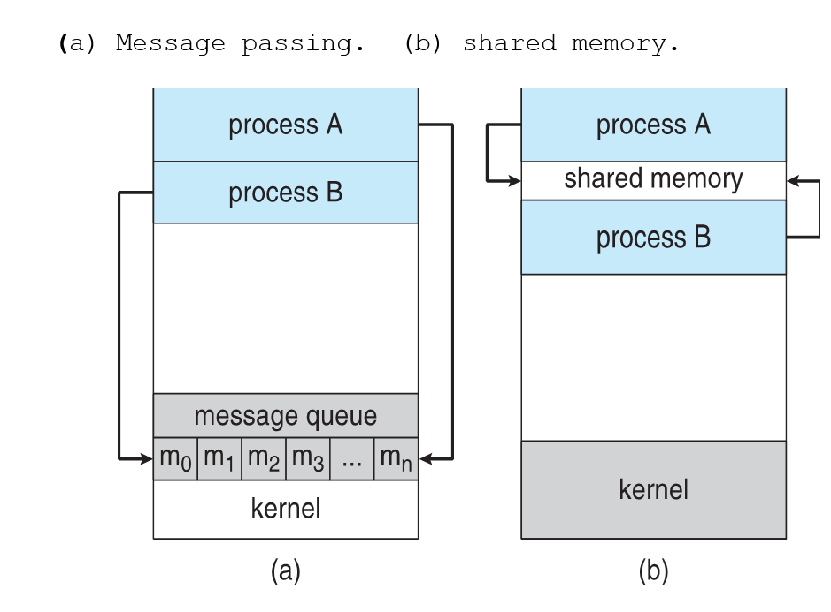

Slide 24
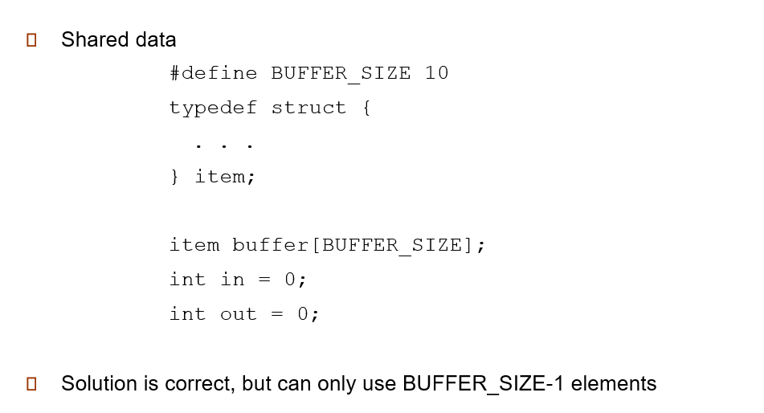
Notes:
How the bounded buffer using circular array for the producer consumer problem

Slide 25
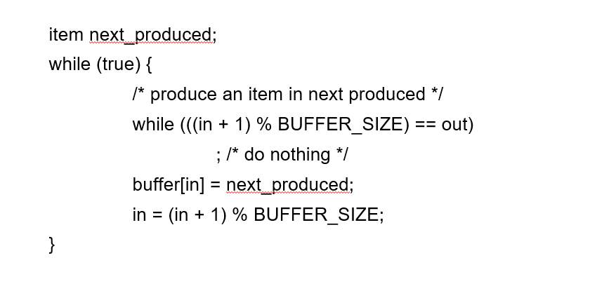
Producer process

Slide 26
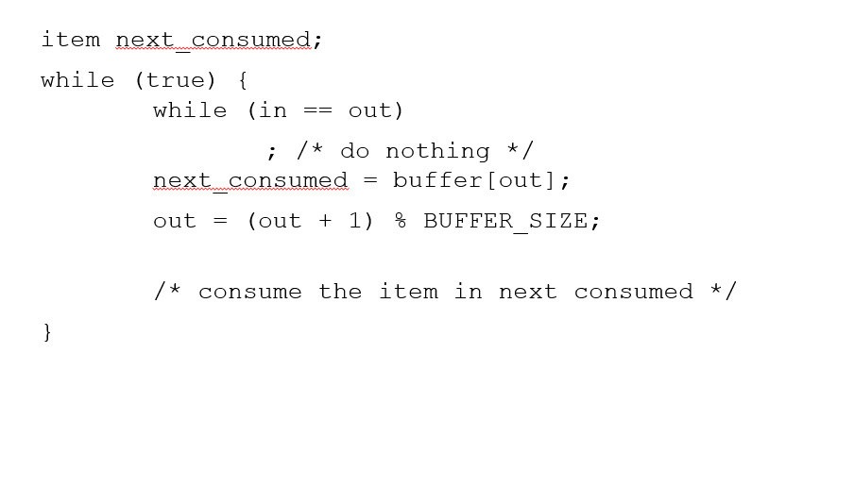
Consumer process

